Slide 1
ITCS 3134
YIN HANG KWOK
E14 - Boundary Extraction

Slide 2
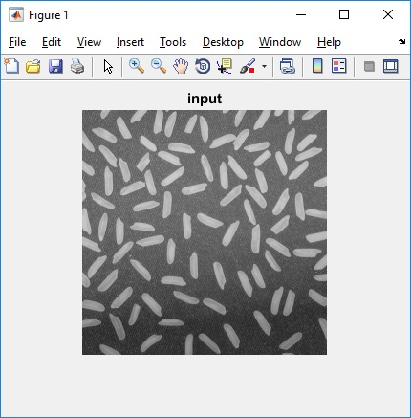
input image, f

Slide 3
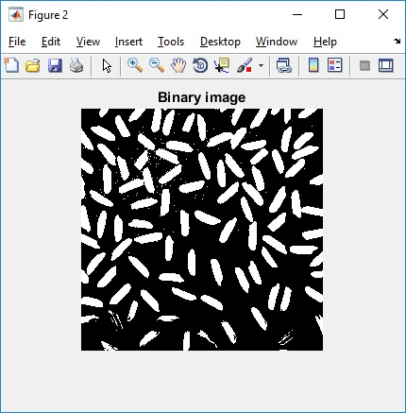
binary image, g

Slide 4
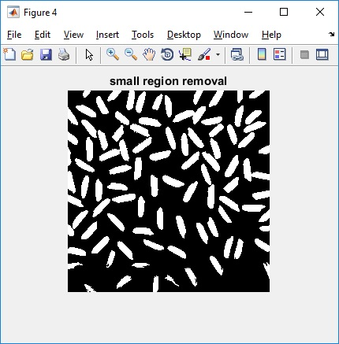
binary image after small region removal

Slide 5
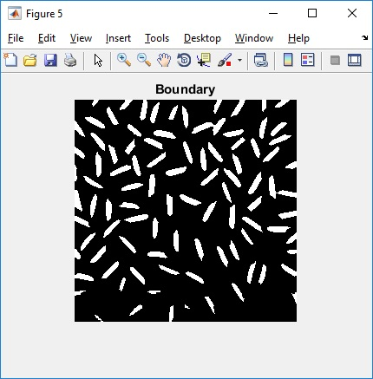
erosion image

Slide 6
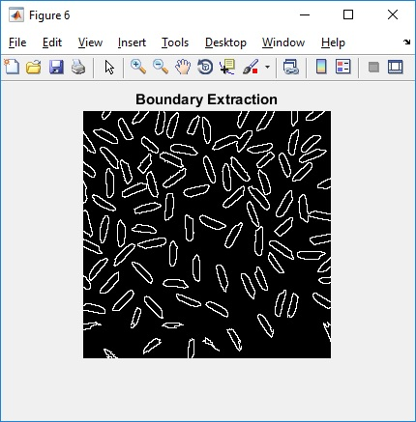
final boundary image

